Slide 1
From Micro-Behaviors to Macro-Phenomena
An Introduction to Agent-Based Modeling
21 September 2026
The 26th European Agent Systems Summer School
EASSS 2026
Malmö University

Slide 2

Tutorial team
This tutorial was developed and delivered at EASSS 2026 by Sz-Ting (Christine) Tzeng, with contribution from Bertilla Fabris to the hands-on assignment session.
The slides available on this website are a revised version prepared by Christine Tzeng. They include theory-focused content and a hands-on modeling session, but do not include the hands-on assignment materials.
Sz-Ting (Christine) Tzeng
Focus: multi-agent systems, human-centered AI, and value alignment

Slide 3
Learning Goals
Explain the core components of an agent-based model: agents, environments, states, rules, interactions, and emergent outcomes
Explore and analyze foundational ABMs in NetLogo by changing parameters, observing, and interpreting system dynamics
Connect local behavior, heterogeneity, and interaction to macro-level social patterns
Assess how alternative rules or interventions affect simulated outcomes, and recognize the limits of policy inference
Design an ABM for a real-world problem, including agents, states, interaction rules, outcomes, and possible interventions

Slide 4
Foundations of Agent-Based Modeling

Slide 5
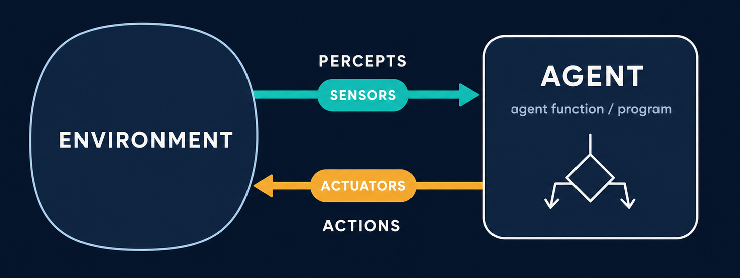
What is An Agent?
Russell, S. J., & Norvig, P. (2021). Artificial Intelligence: A Modern Approach (4th ed.). Pearson.

Slide 6
“Agent” Disclaimer
ABM agent ≠ LLM-based agent
ABM AGENT
A model component
Person / household / wolf
Patient / hospital
Vehicle / pedestrian
Goal: Represent interactions and examine system outcomes
LLM-BASED AGENT
An AI system architecture
LLM + memory + tools
Planning / API calls
Task completion
Goal: perform or assist with tasks in an environment

Slide 7
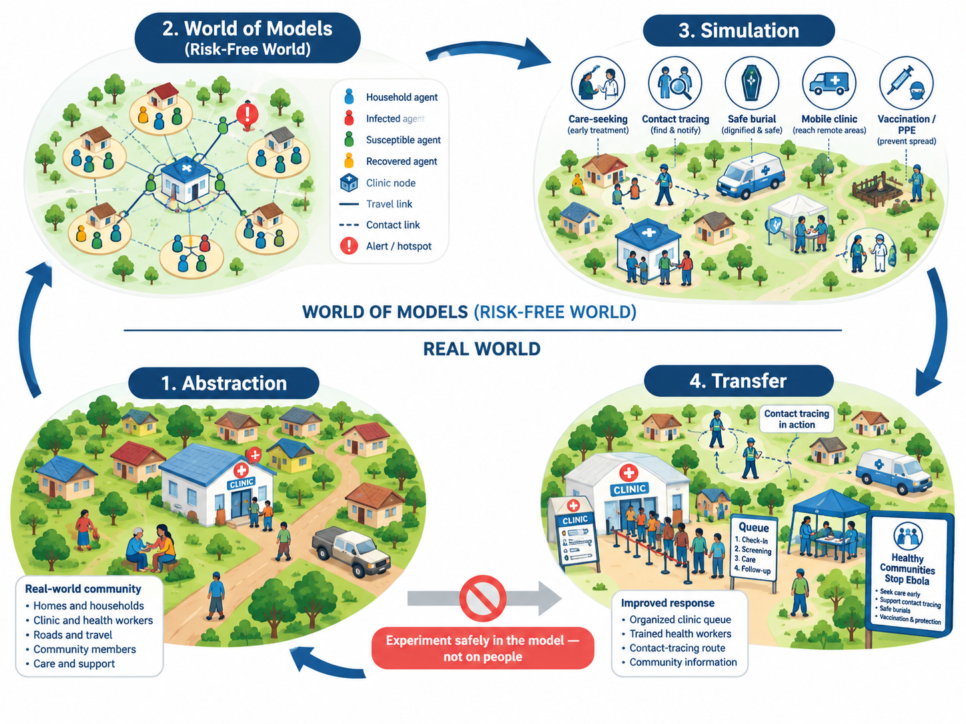
A Model Is a Purposeful Abstraction
Prediction
Explanation
Description
Exploration
Illustration
Analogy
Social learning
Optimization
Edmonds et al. (2019) JASSS, Different Modelling Purposes

Slide 8
Where Does ABM Sit? AI, MAS, and Social Simulation
ARTIFICIAL INTELLIGENCE
Build computational capabilities
Learning · reasoning · planning
MULTI-AGENT SYSTEMS
Study interacting autonomous agents
Coordination · interaction · communication
AGENT-BASED MODELING
Model agents, environment, and local rules
Simulate interaction over time
SOCIAL SIMULATION
Study social dynamics through computational models
Institutions · behavior · policy
Micro-behaviors → Macro-phenomena
Segregation · epidemic trajectories · market dynamics

Slide 9
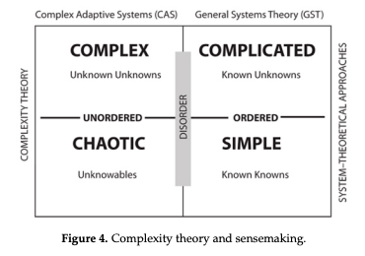
What Makes A System Complex?
Heterogeneity: Actors differ in state, resources, beliefs, or decision rules
Local interaction: Agents respond to other agents and information within their interaction neighborhood
Feedback: Effects loop back and alter later behavior
Adaptation: Behavior changes as conditions change
Nonlinearity: Small changes can produce disproportionate outcomes
…
Turner, J. R., & Baker, R. M. (2019). Complexity Theory: An Overview with Potential Applications for the Social Sciences. Systems, 7(1), 4. https://doi.org/10.3390/systems7010004

Slide 10
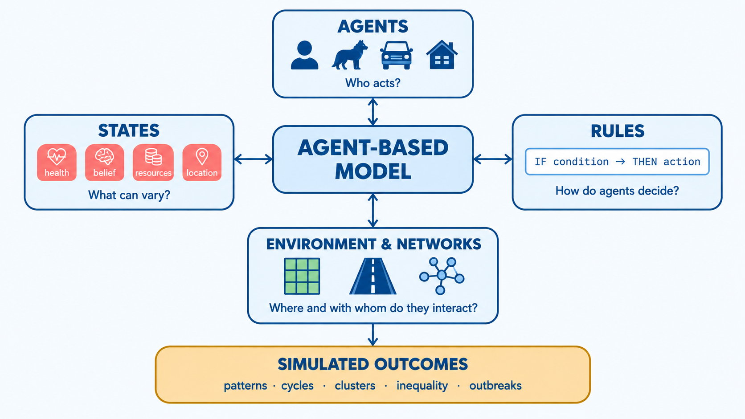
What is ABM
Agent-Based Modeling Makes Mechanisms Explicit
ABM simulates heterogeneous autonomous entities and their interactions to explore how collective patterns and dynamics emerge

Slide 11
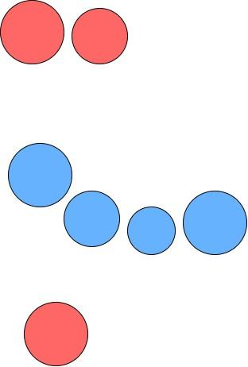
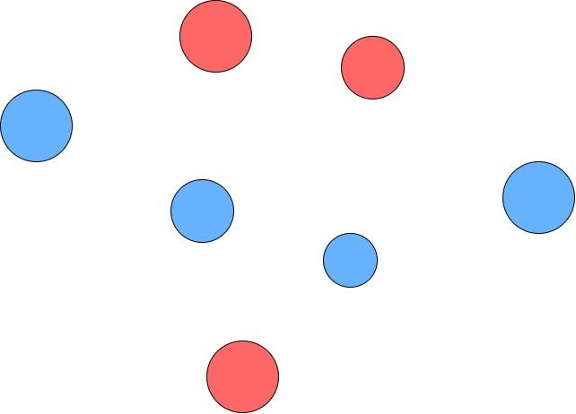
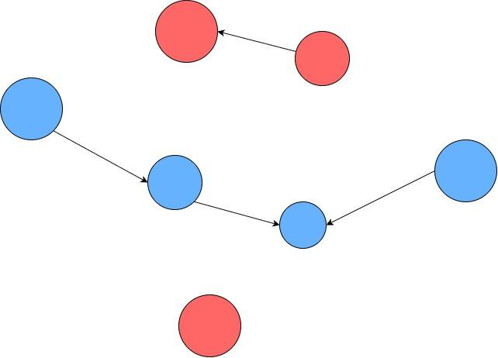
Emergence: From Micro-Behaviors
to Macro-Phenomena
How can simple local choices produce collective patterns?
Macro pattern emerges: clustering
Individual Agents
Agents observe, react, and adapt locally

Slide 12
Why Use ABM Instead of Only Averages or Population-Level Variables?
Do individual differences matter?
Model agents with different resources, beliefs, health states, or preferences.
Do local interactions matter?
Represent contagion, social influence, neighborhood effects, and network structure.
Does feedback change behavior?
Observe adaptation, path dependence, tipping points, and non-linear effects.
Can a policy alter local rules?
Compare interventions such as early versus late quarantine.

Slide 13
Advanced ABM

Slide 14
Hidden States
Behavior Is Visible. Its Drivers May Not Be
Visible Layer
Moves to another location
Avoids contact
Accepts vaccination
Shares or withholds information
Observable action
Internal Layer
Health status
Belief / risk perception
Preference
Resource constraint
Internal state— not directly observable by other agents
ABM can model a distinction between what agents do, what agents know, and what observers can see.

Slide 15
Hidden States Change Collective Dynamics
Internal state
Health: infected but asymptomatic
Local decision
Continues moving and meeting others
System outcome
Unobserved transmission can accelerate spread
Examples:
Belief → chooses whether to comply → intervention outcome
Preference → choices of contacts or location → clustering or segregation

Slide 16

Policy Becomes a Mechanism In ABM
The policy effect comes from the modeled mechanism
Before intervention
Infected agent moves and contacts nearby agents
Policy mechanism
Reduce or remove mobility / contact after becoming infected
After intervention
Fewer contact opportunities

Slide 17
Practical Exercise

Slide 18
Policy Exploration
When does the response begin?
Record these outcomes for discussion:
Peak number infected
Time to peak
Total infections
Number or duration of restricted agents
Assumptions and random seed / repeated runs
 | Early intervention | Late intervention
Random vaccination | Condition A | Condition B
Targeted vaccination | Condition C | Condition D
Who receives protection?
Notes:
Change one mechanism at a time. Run each condition repeatedly. Then explain the causal pathway—not only which curve is lower.

Slide 19
Collaborative Design Canvas
Sample problems:
Outbreaks
Virus on a Network
Misinformation
Rumor Mill
Residential Clustering
Segregation / Schelling
Resource Distributions
Simple Economy
When does a local outbreak require targeted protection?
How does misinformation spread, and which response slows it?
Can preference changes reduce residential clustering?
What produces unequal resource distributions?

Slide 20
Collaborative Design Canvas
Bring your own problem
Problem
Agents
State variables
Decision rules
Interactions
Outcomes
Candidate intervention

Slide 21
Get In Touch
Sz-Ting (Christine) Tzeng
christinetzeng321@gmail.com
Notes:
Here we just introduce ourselves

